Slide 1
CAR RENTAL SYSTEM DBMS PROJECT
Name: K. Sreesh Reddy
SRN: PES1201801580
Section: E

Slide 2
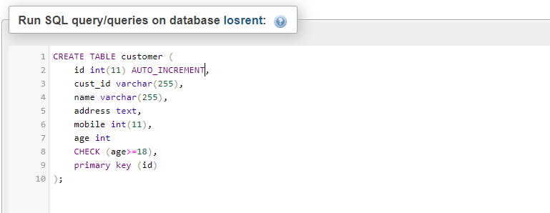
Creating table with CHECK Constraint
Fig: Creating a table with age greater than or equal to 18 to be checked.

Slide 3
We give the CHECK constraint while creating the table itself.
We check if the age of the customer is greater or equal to 18.
If it isn’t then the information is not added to the database.

Slide 4
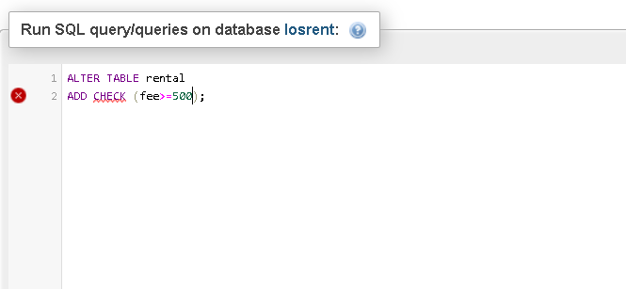
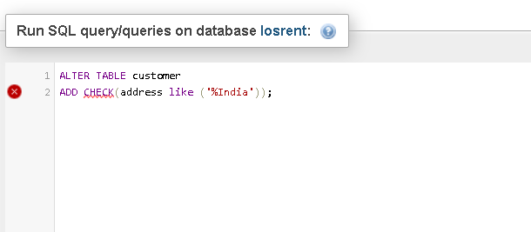
Fig: Checking if the fee is greater than 500
Fig: Checking if the addresses end with ‘India’

Slide 5
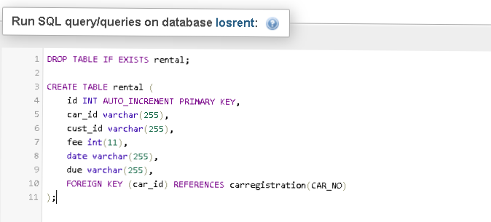
Creating Referential Integrity Constraints
Fig: Creating rental table which referential integrity constraint.

Slide 6
Referential Integrity constraints basically mean that the foreign key of any table must be referencing a primary key of another table. Therefore, the value of the foreign key will always be null or available in the domain of the primary key.
In this example, we consider the car_id in the rental table to be the foreign key which refers to the primary key of the carregistration table, which is CAR_NO.

Slide 7
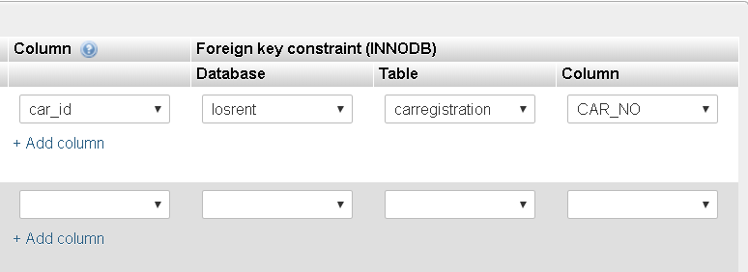
Fig: Seen in relational view, the car_id in rental referring CAR_NO.

Slide 8
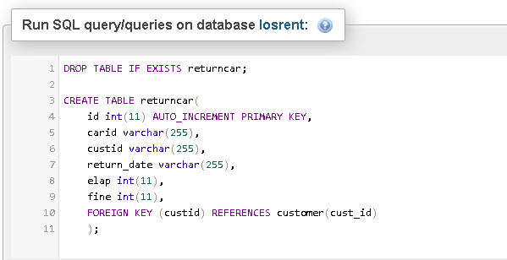
Fig: Creating table returncar with referential integrity constraint.

Slide 9
Similarly here, the returncar table has the foreign key custid which is referring to the primary key of the customer table, which is cust_id.

Slide 10
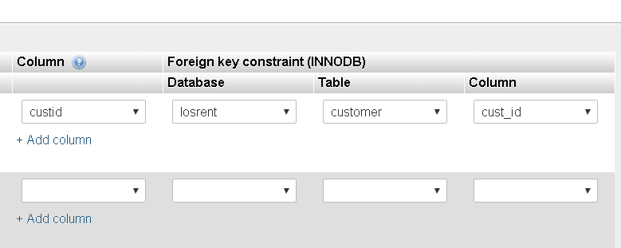
Fig: As seen in relational view, custid attribute of returncar is referring to cust_id

Slide 11
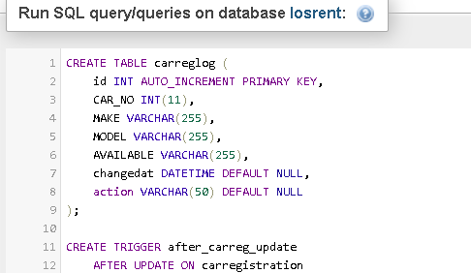
Creating a TRIGGER
Fig: Creating table in which trigger helps put values.

Slide 12
We first create a table that will maintain a record of when the car registrations were changed or updated.

Slide 13
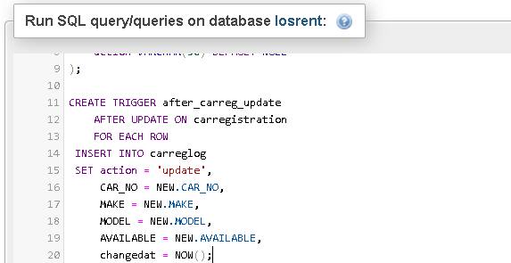
Fig: Creating a trigger.

Slide 14
Trigger is a database object that is associated with a table. It is activated when we use either of INSERT, UPDATE or DELETE command.
It can be activated before or after the command is executed.
In this example, we create a trigger which is activated after the table carregistration is updated.

Slide 15
The job of this trigger is to check whenever there is a value updated and store that tuple in the table carreglog. It also stores the time when it was updated so as to keep track of the changes made in the logs.
The application is that it makes it secure and all changes are recorded somewhere.

Slide 16
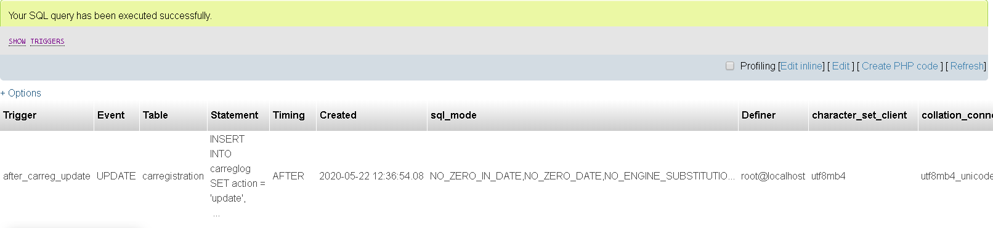
Fig: Showing the Trigger created by us by using the query SHOW TRIGGERS;.

Slide 17
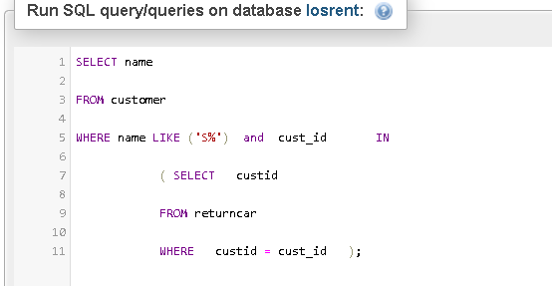
Complex SQL Queries
Fig: A nested SQL query.

Slide 18
The above complex SQL query is a nested query which is used to find out the people who have returned the car whose names start with S.
For that we use the customer ID, which is the link between customer data and the returned cars’ data.

Slide 19
We find all the customer ids which are stored in the returncar table and then go back to the customer table and check which of these ids correspond to names starting with S.

Slide 20
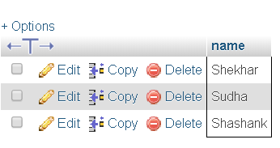
Fig: Output of the query performed.

Slide 21
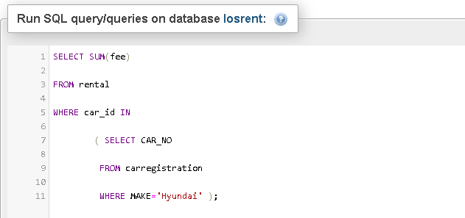
Fig: Complex SQL Query to find SUM of fee for cars made by Hyundai

Slide 22
We write one more complex SQL query where we have to find out the total amount paid (barring fines) by the customers for the cars manufactured by Hyundai.

Slide 23
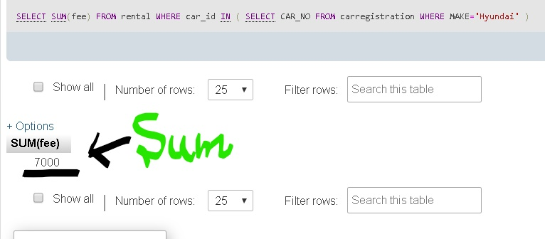
Fig: Output of the query performed.

